Slide 1
Primary source, decay modeling and modular physics list
Lecture 5

Slide 2
In this lecture
Sources - how to set up G4ParticleGun, how to sample starting parameters and how to use your own histogram as a distribution
How to use radioactive nuclide as a source and how Geant4 models decay
PhysicsList - see how modular physics list works and how you can modify it
How to look inside Geant4 decay data - levels and decay channels of a nuclide
Data collection when a whole decay chain happens in one event
Example - the same clover HPGe detector from lecture 4, now with ²⁵²No and alpha-spectrum sources!

Slide 3
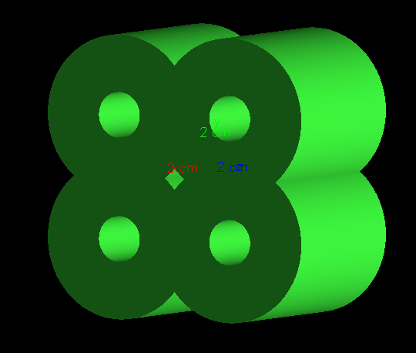
Clover from lecture 4
DetectorConstruction.cc and vis.mac are exactly the same as in lecture 4 - 4 germanium leaves, copy numbers 0...3, everything in vacuum
Crystals are 80 mm long - from z = -40 mm to z = +40 mm, holes are open to the back side
The source is now not in the center, but on the axis in front of the clover: (0, 0, 50 mm) - 1 cm from the front face
What is new: PrimaryGeneratorAction, PhysicsList, EventAction and SteppingAction (hits with time), RunAction (NuclideDump and file names), ActionInitialization (Z and A from main)

Slide 4
Primary source
Let’s again remember lecture 2
Event start from a primary particles. You create them and set up their properties in PrimaryGeneratorAction. You can create several primary particles in one event.
Primary particles can produce secondary particles - scattering, ionization, gamma processes, scintillation, etc.
Particles do not interact with each other. Geant4 models interaction of particles with a material! It does not simulate collisions between simultaneously transported tracks!
We will learn how to set up and use G4ParticleGun.
There is also a G4GeneralParticleSource - it is more macro-based, allows to use some included energy distributions, momentum distribution, etc. - see examples/extended/eventgenerator/exgps for details - we will not study it
You can use radioactive nuclei with 0 kinetic energy as primary particles. Geant4 will model its decay and decay of its daughters - if your physics list is properly set up for it!

Slide 5
PrimaryGeneratorAction
First you set particle definition:
auto ion = G4IonTable::GetIonTable()->GetIon(22,50); // (Z,A) = Ti50
fParticleGun1->SetParticleDefinition(ion);
Then you set up its properties:
auto Energy = 280*MeV;
fParticleGun1->SetParticleEnergy(Energy);
fParticleGun1->SetParticleMomentumDirection(G4ThreeVector(0,0,1));
fParticleGun1->SetParticlePosition(G4ThreeVector(0, 0,-1*um));
You can use random engine to set up starting parameters!
G4UniformRand() – gives uniform random number from 0 to 1.
G4RandomDirection() – gives isotropic G4ThreeVector on unit sphere
G4RandGauss::shoot(mean, sigma) – gives gaussian distributed value
G4RandGeneral - you can give your own pdf in histogram format
fParticleGun1->GeneratePrimaryVertex(anEvent); - this command generates primary particle for the event

Slide 6
G4RandGeneral
You can read and use any histogram-defined distribution in your simulation setup
Let’s say you have read your distribution into a vector:
std::vector<G4double> spectrum;
It can be non-normalized, but the bins must have uniform width!
Bin content also should be non-negative!
Then you create a generator:
fSampler = new CLHEP::RandGeneral(spectrum.data(), spectrum.size(), 0);
The last argument defines how values are sampled inside a bin: 0 - continuous distribution, the value is uniform inside the bin; 1 - discrete, returns the bin's lower edge, so you get one value per bin
You histogram will be renormalized and rescaled: it will become a distribution from 0 to 1!
For example, your input histogram is two peak energy distribution from 7000 to 9000 keV - RandGeneral keeps the same structure, same number of bins, same shape, but normalizes in Y and maps X to (0,1)
So you should also keep the lower edge of your first bin and the upper edge of your last bin during histogram reading. Then you use them to rescale generated value to your original range:
G4double E = fEmin + fRange * fSampler->shoot();

Slide 7
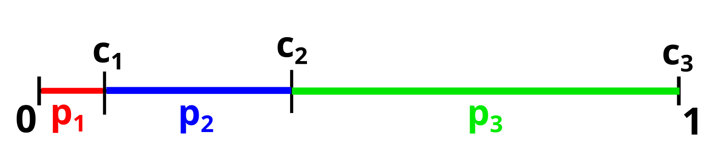
Generating activity mix
Let’s say you want to model several different types of primary particles in your spectra: your alpha source have 3 lines,or you want to see the spectrum from several particles, etc.
Let’s say for example that you have 3 possible versions of primary p₁, p₂, p₃
We can model them using uniform distribution - remember lecture 3 and discrete processes!
First we calculate a discrete cdf
Then we use uniform distribution to decide which version happened
Let’s say in our example we have pdf: p₁ = 0.1, p₂ = 0.3, p₃ = 0.6
Cdf will be:
c₁ = Probability that its p₁: 0.1
c₂ = Probability that its p₁ or p₂: 0.1 + 0.3 = 0.4
c₃ = Probability that is p₁ or p₂ or p₃ = 0.1 + 0.3 + 0.6 = 1
Then you generate point η from 0 to 1 and depending on interval in which it went, you choose your source!

Slide 8
Decay physics in Geant4
Geant4 can model decay of radioactive nuclei by α, β⁺, and β⁻ emission, electron capture, spontaneous fission, isomeric transitions, neutron and proton emission.
Spontaneous fission is not modeled properly!
Uses ENSDF data for levels, energies and half-lives
Decays are modeled both in flight and at rest
A rest-discrete process G4RadioactiveDecay is used!
It calculates mean free path from particle mean lifetime and velocity:
λ=γβcτ
where τ is the mean lifetime, βc - particle velocity, γ = 1/sqrt(1-β²) - time-dilation factor. βc converts time to distance. A fast particle's lifetime measured in the lab is γτ, longer than its rest-frame lifetime τ. For non-relativistic particles γ ≈ 1.
This mean free path is then used in step length competition algorithm which we discussed in lecture 3 - number of mean free paths is sampled as -ln(η)!
If particle stops - similar competition begins in time steps between processes which act at rest - capture, decay, annihilation, etc.
Time steps are sampled t = -τ ln(η), shortest is chosen and its process acts!

Slide 9
Example: radioactive nuclei source in Ge detectors
We take the clover-like Ge detector from lecture 4 - geometry is not changed
Two sources: alpha-particles with energy sampled from a measured spectrum and a radioactive nuclide at rest
We use Geant4 decay database to model different radioactive nuclides as sources - and look at the whole decay chain!

Slide 10
PhysicsList
In previous examples we built physics list from scratch - adding processes one by one
Here we will use modular physics list - G4VModularPhysicsList
It registers different G4VPhysicsConstructor modules which describe different regions of physics. There are 9 physics constructor types in Geant4:
0. Other: optical, exotic physics, nuclear decay, thermal neutron transport, step limiters, tracking cuts, everything which is not listed in other categories.
1. Transportation: enables particle movement and navigation. AddTransportation() enables it. Enumerated mostly for completeness, every G4VModularPhysicsList calls it
2. Electromagnetic physics: ionization, scattering photon interactions - photoelectric, Compton, conversion, Rayleigh
3. Extra physics processes for gamma and leptons: gamma-, electro- and muon-nuclear reactions, plus synchrotron radiation
4. Decay: decay of unstable particles. (pions, muons, neutrons, etc.). G4RadioactiveDecayPhysics - for nuclides - is type 0.

Slide 11
PhysicsList
5. hadron elastic — elastic scattering of hadrons on nuclei: the projectile survives, the nucleus recoils, nothing is created
6. hadron inelastic — everything else a single hadron can do to a nucleus:
spallation, capture, fission, fragment production.
7. stopping particles capture processes — what happens to negatively charged particles that stop in matter: decay and absorptions. Competes at rest, in time, not in space.
8. ion nuclear interactions — nucleus-nucleus collisions: deuteron, triton, He3, alpha and any ion. Geant4 is not very good in low-energy heavy-ion reaction physics - no multinulceon transfer, no quassi-fission, only some fusion models.

Slide 12
PhysicsList
Lets look and Geant4 default physics list - FTFP_BERT
Here how it registers all this types(FTFP_BERT.cc):
// EM Physics - type 2
RegisterPhysics(new G4EmStandardPhysics(ver));
// Synchroton Radiation & GN Physics - type 3
RegisterPhysics(new G4EmExtraPhysics(ver));
// Decays - type 4
RegisterPhysics(new G4DecayPhysics(ver));
// Hadron Elastic scattering - type 5
RegisterPhysics(new G4HadronElasticPhysics(ver));
// Hadron Physics - type 6
RegisterPhysics(new G4HadronPhysicsFTFP_BERT(ver));
// Stopping Physics - type 7
RegisterPhysics(new G4StoppingPhysics(ver));
// Ion Physics - type 8
RegisterPhysics(new G4IonPhysics(ver));
// Neutron tracking cut - type 0
RegisterPhysics(new G4NeutronTrackingCut(ver));

Slide 13
PhysicsLists
You can take some of the Geant4 physics lists and replace modules in them:
auto* physics = new FTFP_BERT;
physics->ReplacePhysics(new G4EmStandardPhysics_option4());
Or add new modules which weren’t registered:
physics->RegisterPhysics(new G4RadioactiveDecayPhysics());
Or remove some module if it is not needed in your simulation:
physics->RemovePhysics(bEmExtra)
Here are the enumerators and indices for each physics type (see G4BuilderType.hh)
bUnknown = 0, bTransportation = 1, bElectromagnetic = 2, bEmExtra = 3, bDecay = 4, bHadronElastic = 5, bHadronInelastic = 6, bStopping = 7, bIons = 8
RemovePhysics(type) removes the first module of that type. Since you can have several of type 0, use the name or pointer overload for those.

Slide 14
PhysicsList
There are typically several options for each module depending on the use case!
You must use only one G4VPhysicsConstructor for modules 2-8!
If you try to register more than one - Geant4 will keep the first one and give warning.
You can register any amount of type 0 modules
Please consult the guide on physics list before modeling, it shows all of the possible reference physics lists and their usage: https://geant4-userdoc.web.cern.ch/UsersGuides/PhysicsListGuide/html/physicslistguide.html
And check the physics reference manual which describes actual theoretical models or experimental data behind each physics process:
https://geant4-userdoc.web.cern.ch/UsersGuides/PhysicsReferenceManual/fo/PhysicsReferenceManual.pdf
A lot of physics is not added in Geant4, some of it is still unfinished!
An example - spontaneous fission - we will check it in the lecture

Slide 15
PhysicsList
We will look at ²⁵²No decay chain
Electromagnetic physics - default G4EmStandardPhysics()
2 decays - for nuclides (G4RadioactiveDecayPhysics) and for particles (G4DecayPhysics) - we will have unstable neutrons
Neutrons - G4HadronElasticPhysicsHP and G4HadronPhysicsFTFP_BERT_HP: below 20 MeV elastic, inelastic, capture and fission of neutrons use evaluated G4NDL data
G4RadioactiveDecayPhysics also switches on Auger electrons and fluorescence X-rays in EM parameters - you get atomic relaxation after EC and internal conversion
De-excitation: we enable correlated gamma emission (off by default), internal conversion is on by default
You can add your own nuclide states and decay properties, see PhysicsList.cc for details

Slide 16
PhysicsList: nuclide table
G4NuclideTable reads ENSDFSTATE.dat - it decides which nuclear levels exist as separate ions and what are their lifetimes. How they decay is in another dataset - files z<Z>.a<A> in G4RADIOACTIVEDATA
G4NuclideTable::GetInstance()->SetMeanLifeThreshold(10.*ns);
Ground states are always there. Excited level becomes a separate ion only if its mean life is longer than threshold (default is 1 ns). Shorter-lived levels are handled within nuclear de-excitation
G4NuclideTable::GetInstance()->SetLevelTolerance(10.*eV) - Window for finding a level by its excitation energy (default is 1 eV). Important if you call GetIon(Z, A, Eex) - miss the tabulated energy and you get an ion without its known half-life!
Both are set in PhysicsList constructor - before initialization

Slide 17
PhysicsList: changing a process
Physics constructors build processes themselves - but you can still find a process and change it. We do it in ConstructProcess:
void PhysicsList::ConstructProcess()
{
G4VModularPhysicsList::ConstructProcess();
G4RadioactiveDecay* rdm = dynamic_cast<G4RadioactiveDecay*>(
G4ProcessTable::GetProcessTable()->FindProcess(
"RadioactiveDecay", G4GenericIon::GenericIon()));
if (rdm == nullptr) return;
rdm->SetNucleusLimits(G4NucleusLimits(1, 300, 0, 120));
rdm->SetThresholdForVeryLongDecayTime(15*year);
}
Base class ConstructProcess() goes first - it builds everything, only after it the process exists
FindProcess searches by process name and particle
Wrong name - you get nullptr and the code just returns. No effect from your changes? Check this pointer first!

Slide 18
NuclideDump.cc
Geant4 by default doesn’t have an easy way to get the tabulated nuclear levels and decay
Two functions were vibe-coded and tested to do this
They print registered nuclear levels and products of each decay mode
It can be used after run initialization in BeginOfRunAction:
if (isMaster) {
DumpLevels(Z, A); // every tabulated state
DumpDecayTable(Z, A, 0); // how its ground state decays
DumpDecayTable(Z, A, 1); // how its first state decays
}
It will then show all registered levels and decay from ground state and first level!
It works in 11.4.2 but can stop working in the future

Slide 19
PrimaryGeneratorAction
In the example we will look at 2 possible generators: from experimental alpha-spectra and from radioactive nuclei
In first we read a .txt file of histogram with registered alpha spectrum and use it to create a G4RandGeneral
This generator will sample an energy and we will give it to isotropic alpha-particle
It’s only an example on how to use the method
In second we put a radioactive nuclei and register it decay chain
Will collect the decay energy spectra for each crystal and total detector - 5 histograms!
A full simulated decay chain happens during one event - we start with a primary and all decay products are secondaries - so spectra can get quite complex even using one nuclide as source!

Slide 20
PrimaryGeneratorAction: nuclide
Z and A of the source are set in main: G4int Z = 102, A = 252; They go to ActionInitialization(Z, A), and from it to PrimaryGeneratorAction and RunAction
Source type is chosen by flags in PrimaryGeneratorAction.hh - #define NUCLIDE or #define SPECTRUM. Flags are in .hh because RunAction also needs them for the file name
NUCLIDE:
auto nuclei = G4IonTable::GetIonTable()->GetIon(fZ,fA);
fParticleGun1->SetParticleDefinition(nuclei);
fParticleGun1->SetParticleMomentumDirection(G4RandomDirection());
fParticleGun1->SetParticlePosition(G4ThreeVector(0, 0, 50*mm));
fParticleGun1->SetParticleEnergy(0.);
fParticleGun1->SetParticleCharge(0.);
Energy is 0 - nucleus is at rest, so it decays by the at rest part of G4RadioactiveDecay
Charge is 0 - by default gun takes charge from the particle definition, +Z·e, a bare nucleus. We make it a neutral atom sitting in the source. Official example rdecay01 does the same
Output file: decay_Z_102_A_252_<run number>.root

Slide 21
PrimaryGeneratorAction: spectrum
SPECTRUM: spectrum.txt has two columns - bin center in keV and number of counts. 450 bins of 10 keV, from 5000 to 9500 keV
CMakeLists.txt copies it into build directory, it is read once in the constructor:
while (ifs >> bin_center >> bin_count) {
spectrum.push_back(bin_count);
centers.push_back(bin_center);
}
bin_width = centers[1] - centers[0];
fEmin = centers.front() - bin_width/2.;
fEmax = centers.back() + bin_width/2.;
fRange = fEmax - fEmin;
fSampler = new CLHEP::RandGeneral(spectrum.data(), spectrum.size(), 0);
Then for each event an isotropic alpha gets energy from the sampler:
G4double Energy = fEmin + fRange*fSampler->shoot();
fParticleGun1->SetParticleEnergy(Energy*keV);
Values in the file are just numbers - we multiply by keV ourselves! Output: alpha_spectrum_<run number>.root

Slide 22
Data collection
We will create 5 histograms in RunAction (65536 bins from 0 to 300 MeV) and reopen file each run
We will also use ActionInitialization to distribute information about source in PrimaryGenerator and RunAction!
In PrimaryGenerator it will be used to set up the source nuclei
In RunAction it will be used to create output filename
We can’t use our typical data flow if we want to get somewhat realistic detector spectra - if we just accumulate the deposited energy, all decay products will be summed up - remember, all decay chain happens in one event
So, you will get the sum of alpha decays of whole chains - like your detector piles up everything!
To overcome this, we will collect hits - each energy deposition and its time - and then process them in EndOfEventAction
We will unite energy deposition which happened in window of 10 us - similar to a HPGe detector shaping time - and write the united value to a histogram

Slide 23
Data collection
For this we will create a struct Hit { G4double time; G4double edep; G4int leaf; };
We will collect them in EventAction in vector
Then we will sort them in time and write data in histograms, uniting all energy deposits which happened in 10 us window!
You can try to do it directly in stepping action if you like but Geant4 time jumps - it model full particle track one after another
In the EndOfEventAction we first sort all hits in time
Then we accumulate depositions which happened in the same 10 us window and fill the histograms witch accumulated values - see code for details!
One problem - for very long decay times, floating-point precision of global time limits ability to resolve nearby hits. Around thousands of years, this becomes significant with window of 10 us

Slide 24
Results
Let’s first look at ²⁵²No
If you just add RegisterPhysics(new G4RadioactiveDecayPhysics()) without any modifications to your physics list - you will not get anything!
By default, Geant4 effectively treats all Z>100 or A > 260 nuclei as stable even if it has some data
We change it in ConstructProcess:
rdm->SetNucleusLimits(G4NucleusLimits(1, 300, 0, 120));

Slide 25
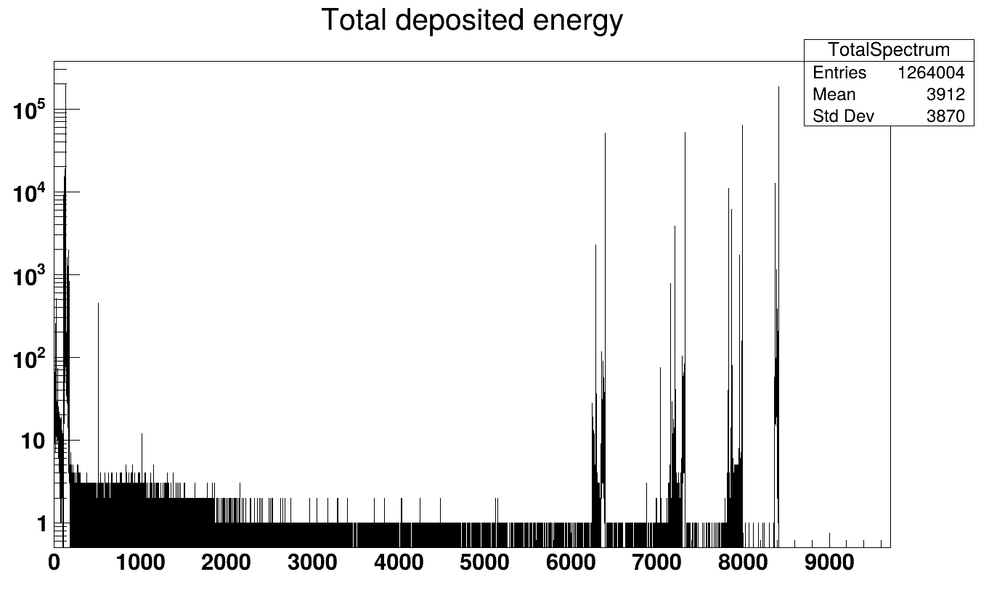
Results
Our geometry is not very good - nuclei sits in vacuum 1 cm before Ge detector, so efficiency is quite low, ~40% for alphas
~60% of source nuclei will recoil from the detectors in the vacuum and will be lost, 40% nuclides will implant in the detectors
It’s all unphysical in a way - actual Ge detector typically have a dead layer, so part of the energy will be lost there
Spectra is somewhat realistic - we can see 4 groups of peaks for alpha decay of ²⁵²No, ²⁴⁸Fm, ²⁴⁴Cf, and ²⁴⁰Cm
Also we see a lot of low energy stuff from recoils, beta decay,escaped alphas, etc.!
No SF though - we don’t have any fragment-like energy - Geant4 can’t model fragments and nuclei is just destroyed in this branch
Also no ²³⁶Pu - it has a half-life of 2.86 years

Slide 26
Spontaneous fission in Geant4
There is a LLNL table of isotopes for which it will model prompt neutrons and gammas from fission and fragments de-excitation, but no fragments itself will be modeled!
LLNL tabulated isotopes:
²³²Th, ²³²U, ²³³U, ²³⁴U, ²³⁵U, ²³⁶U, ²³⁸U, ²³⁷Np, ²³⁸Pu, ²³⁹Pu, ²⁴⁰Pu, ²⁴¹Pu, ²⁴²Pu, ²⁴¹Am, ²⁴²Cm,²⁴⁴Cm, ²⁴⁹Bk, ²⁵²Cf
It can model neutron-induced fission and its fragments though, see physics reference manual and application developer guide for details!
For all nuclei which are not in the table - nothing produced at all!

Slide 27
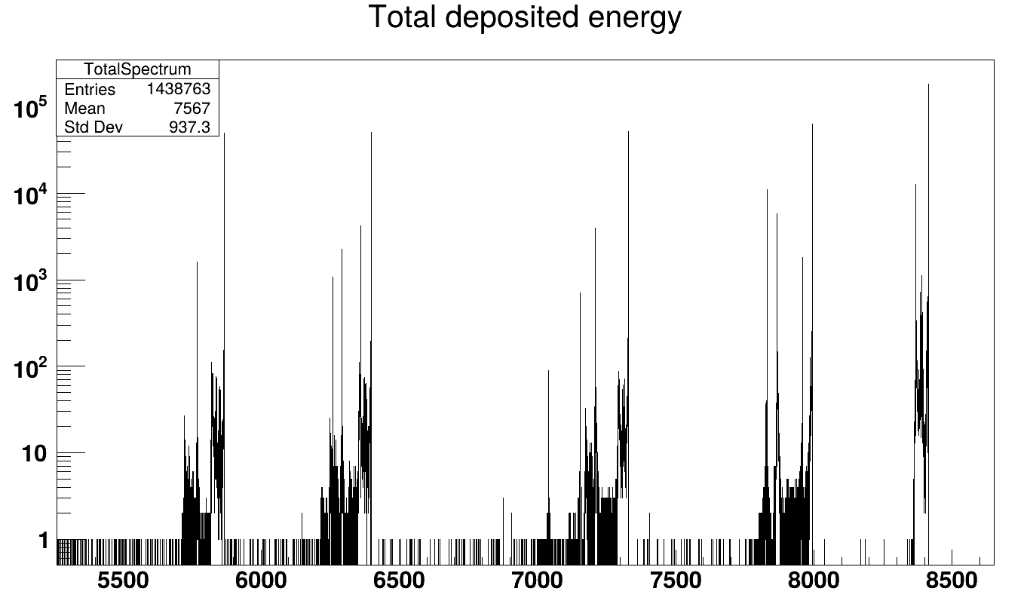
Results
Geant4 has default time limit for mean time of decay set to one year,
Nuclei with mean lifetime above it are not decayed, sampled decays beyond the threshold are also ignored!
Can change it in PhysicsList: rdm->SetThresholdForVeryLongDecayTime(15.*year);
Now we can see additional peaks from ²³⁶Pu in 5.8 MeV area!
Be careful with large decay times! For very long decay times, floating-point precision limits our ability to resolve nearby hits. Around thousands of years, this becomes significant with window of 10 us

Slide 28
Some homework if you like
Set your favourite radioactive nuclei as a source. See the spectra, check for possible errors in the input data files. RunAction dumps daughter and granddaughter assuming alpha decays (Z-2, A-4) - change it for your nuclide!
Set ²¹⁷Th as source. Observe spectrum.
Switch to a source from a spectrum in PrimaryGeneratorAction.hh. See the spectrum, switch 0 to 1 in fSampler creation, observe the difference.
Take the dead layer from lecture 4 homework and add it here. What happens with alphas and recoils? Put the source in a way which will allow to get more information.
Comment out SetNucleusLimits. Check that NuclideDump still prints ²⁵²No levels and decays - but the spectrum is empty. Data being there doesn't mean that decay is on!

